Slide 1
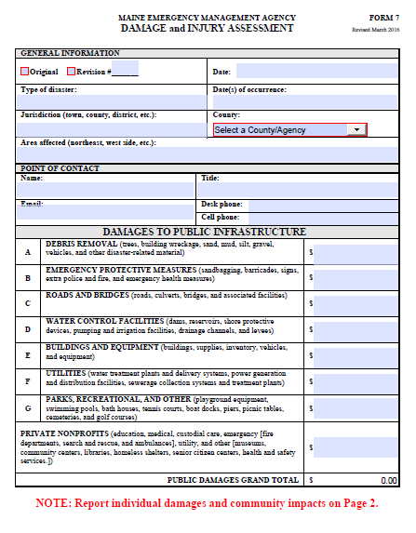

Slide 2
Purpose of FORM 7
MEMA’s initial knowledge of damage extent.
State Partners initial knowledge of recovery needs
Forms a basis for the disaster declaration request.

Slide 3
FORM 7

Slide 4
Project Categories
Eligible work is classified into the following categories:
Emergency Work
Category A: Debris Removal
Category B: Emergency protective measures

Slide 5
Project Categories
Permanent Work
Category C: Roads and bridges
Category D: Water control facilities
Category E: Public buildings and contents
Category F: Public utilities
Category G: Parks, recreational, and other facilities

Slide 6
Categories of Work
Category A: Debris Removal
  In the public interest or public safety
  From public property or rights of way
  Not related to:
    Construction
    Repair
    Renovation of residential or commercial structures
Notes:
.

Slide 7
Categories of Work
Category B: Emergency Protective Measures
YES:
  Actions to save lives and protect public health and safety
  Actions to protect public and private property
  Overtime pay for permanent employees
  Certain stand-by force account labor costs
NO:
  Straight-time pay for permanent employees
  Stand-by time for equipment

Slide 8
Categories of Work
Category C: Roads and Bridges
YES:
  Restore roads, bridges, and their components
  Repair scour or erosion damage to a channel or stream bank if affecting structural integrity of a road, culvert, or bridge
NO:
  Restore work that falls under Other Federal Authority
  Restore private roads
  Repair damage not caused by the disaster

Slide 9
Categories of Work
Category D: Water Control Facilities
YES:
  Restore publicly-owned water control facilities
  Restore carrying or storage capacity of engineered channels, basins, and reservoirs
  Restore flood control works

Slide 10
Categories of Work
Category E: Buildings and Equipment
YES:
  Restore damaged public buildings and their components
  Make upgrades required by codes and standards
  Remediate mold and remove mud, silt, and debris during restoration
  Restore damaged equipment

Slide 11
Categories of Work
Category F: Utilities
YES:
  Restore damaged public utility facilities to pre-disaster design and function
  Clear some disaster-related debris to enable facility access or eliminate immediate threat of further damage
NO:
  Obtain an alternative source of power
  Recoup lost revenues from a shutdown utility
  Private firms such as Central Maine Power or Emera

Slide 12
Categories of Work
Category G: Parks, Recreational, and Other Facilities
YES:
  Restore publicly owned facilities
  Replant necessary vegetation
  Replace sand on beaches, under certain conditions
NO:
  Restore unimproved natural features
  Replant aesthetic vegetation
  Monitor long-term vegetative growth
  Replace destroyed crops

Slide 13
MEMA FORM 7
Tips
Do not include state or federally owned property in estimates
A minimum of $3,100 in costs is needed for reimbursement.
FEMA doesn’t count debris removal activities that cannot be visibly accounted for.
Look for damages that appear to be insignificant.

Slide 14
Public Assistance Overview
Public Assistance provides
  emergency assistance to save lives
  protect property
  assists with permanently restoring community infrastructure
Public Assistance is the largest FEMA grant program
    $4.7 Billion Year/51% of all Grants

Slide 15
Public Assistance Overview
Eligible work must be:
  a result of the declared incident
  be located in the designated area
  Be the legal responsibility of the applicant

Slide 16
Public Assistance Overview
Eligible applicants include:
    States
    Federally recognized tribal governments
    Local governments
    Certain non-profit (PNP) organizations
        Education
        Medical
        Utility
        Emergency Services

Slide 17
Public Assistance Overview
Application Process:
Applicants must submit a Request for Public Assistance within 30 days of the Federal Declaration.

Slide 18
Public Assistance Overview
Funding Formula:
75% Federal Share
15% State of Maine Share
10% Applicant Cost Share

Slide 19
Preliminary Damage Assessment
Disaster Event
Local Damage Assessment
State Verifies Form 7
Request PDA from FEMA
Joint PDA
Request for Federal Assistance

Slide 20
Preliminary Damage Assessment
FEMA’s first step in the declaration process
Federal/State/Local jointly verify damage
Damage assessment teams should be specialized to the task
Fast paced: PDA teams do not inspect 100% of damages
Applicants should target their most significant damages.

Slide 21
Preliminary Damage Assessment
Communities should be prepared to show:
Disaster damage
Disaster photos
Annotated damage map
Any available costs
Written policies
Insurance coverages

Slide 22
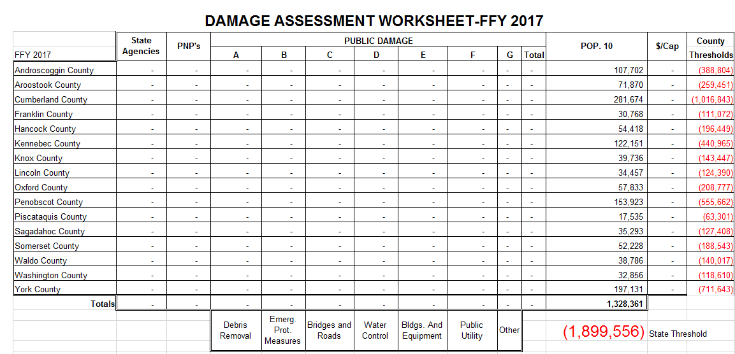
Preliminary Damage Assessment

Slide 23
Preliminary Damage Assessment
Can other Federal Assistance Programs pay for it?
FEMA does not provide disaster assistance for work that is under the authority of Other Federal Agencies:
    Federal Highway Administration
    US Department of Agriculture
    Federal Aviation Administration

Slide 24
Preliminary Damage Assessment
Preliminary Damage Assessment Video:
https://www.youtube.com/watch?v=Lad02ENb44o

Slide 25
How to Estimate and Document
Common methods used to estimate work/costs
  Force Account Labor
  Force Account Equipment
  Leased Equipment
  Supplies
  Contract Services
  Mutual Aid Agreements

Slide 26
How to Estimate and Document
  Eligible Costs for Force Account Labor
  applicant’s personnel
  hourly rates plus fringe benefits
  consistent with pre-disaster overtime policies
  standby time for life safety/public health and safety work
  reasonable and necessary
  adequately documented

Slide 27
How to Estimate and Document
Force Account Labor
What to Document | How to Document
Number of Employees performing a given task | Timesheets or payroll generated reports
Type of Employee | Budgeted or unbudgeted
Type of work being performed | Written description and location of work performed
Regular/overtime hours worked | Timesheets or payroll generated reports
Hourly Rates | Overtime, comp time, and holiday pay policies

Slide 28
How to Estimate and Document
  Eligible Force Account Equipment Costs
  Applicant’s owned equipment
  Hourly rates or mileage rates
  Time the equipment was in use
  Approved equipment rates
  Appropriately documented

Slide 29
How to Estimate and Document
Force Account Equipment Labor
What to Document | How to Document
Type of work and equipment being performed | Written description and location of work performed
Hours used/miles driven | Vehicle Usage logs: operator name and hours/dates worked
Regular/overtime hours worked | Timesheets or payroll generated reports
Average Hourly Rate | Overtime, comp time, and holiday pay policies
Associated equipment rate | FEMA Equipment Rates

Slide 30
How to Estimate and Document
  Eligible Leased Equipment Costs
  Equipment leased by the potential applicant
  Appropriately documented
  Reasonable

Slide 31
How to Estimate and Document
Leased Equipment Costs
What to Document | How to Document
Type of work and equipment being leased | Written description and location of work performed
Cost of leased equipment | Invoices and proof of payment, including fuel; rental agreement

Slide 32
How to Estimate and Document
  Eligible Supply Costs
  Purchases needed for response and recovery supplies and materials
  Reimbursement for supplies taken from the potential applicant’s stock for incident use
  Appropriately documented:

Slide 33
How to Estimate and Document
Supply Costs
What to Document | How to Document
Description of purchased supplies | Invoice of historical record to support the claimed cost (if from stock)
Established method of pricing supplies and materials | Invoices and proof of payment (if purchases)
Prices from area vendors

Slide 34
How to Estimate and Document
  Eligible Contract Service Costs
  Based on the terms of the contract
  Compliance with procurement standards and contract requirements
  Document procurement process

Slide 35
How to Estimate and Document
Contract Services Costs
Federal Procurement Regulations can be found at 2 CFR 200.317-332.
What to Document | How to Document
All contract work | Procurement process documentation
All costs for contract work | Invoices and proof of payment
 | Estimate, bid, or contract (for large projects)

Slide 36
How to Estimate and Document
  Eligible Mutual Aid Agreement Costs
  consistent with past practices for mutual aid
  Document Mutual Aid Process

Slide 37
How to Estimate and Document
Mutual Aid Agreement Costs
What to Document | How to Document
All mutual aid work | Provide Mutual Aid Agreements
All costs associated with mutual aid | Invoices from providing entity (if available)

Slide 38
How to Estimate – Tips
  Use qualified personnel to estimate costs
  Can only claim insurance deductibles
  Use contract estimates or historical cost data
  Base estimates on return to pre-disaster design and function
  Base estimates for vehicles or equipment on the same type make, year, model

Slide 39
Ineligible Costs
  Capital improvements not required by codes and standards
  Loss of revenue
  Loss of useful service life of facilities
  Tax assessments
  Increased operating expenses
  General surveys to assess damage
  Cost of restoring facilities that were not in active use at the time of the disaster.

Slide 40
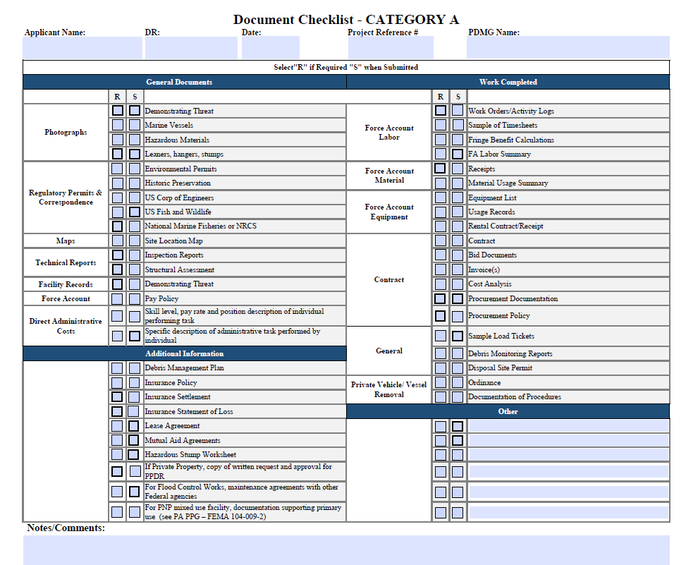
Categories of Work
Category G: Parks, Recreational, and Other Facilities
Work Considered:
  Restore publicly owned facilities
  Replant necessary vegetation
  Replace sand on beaches, under certain conditions
Work Not Considered:
  Restore unimproved natural features
  Replant aesthetic vegetation
  Monitor long-term vegetative growth
  Replace destroyed crops

Slide 41
New PA Delivery Model
New Program Delivery Model:
change procedures
roles and responsibilities
web-based tools
information technology systems (Grants Portal)
New Program Delivery Model does not change:
eligibility
regulations
policies

Slide 42
New PA Model – Grants Portal
Introduction of Grants Portal
Developed to assist the applicants
Facilitates full project visibility
Enhances coordination and communication
User friendly-streamlines work and workflow
Significantly improves document collection and retention

Slide 43
New PA Model – Grants Portal
Complete and update profile information
Submit the Request for Public Assistance
Upload required project documentation
Obtain daily oversight of project statuses

Slide 44
New PA Delivery Model
FEMA is focusing on:
Customer service
Project specific needs
Consistency of personnel and procedures

Slide 45
New PA Model – Grants Portal
Introduction of Program Delivery Manager (PDMG)
Single FEMA Point of Contact
Weekly contact with Applicants
Expected to remain in place through entire disaster
Facilitates exploratory call and recovery scoping meeting
Assists with damage inventory development
Facilitates document collection and coordination

Slide 46
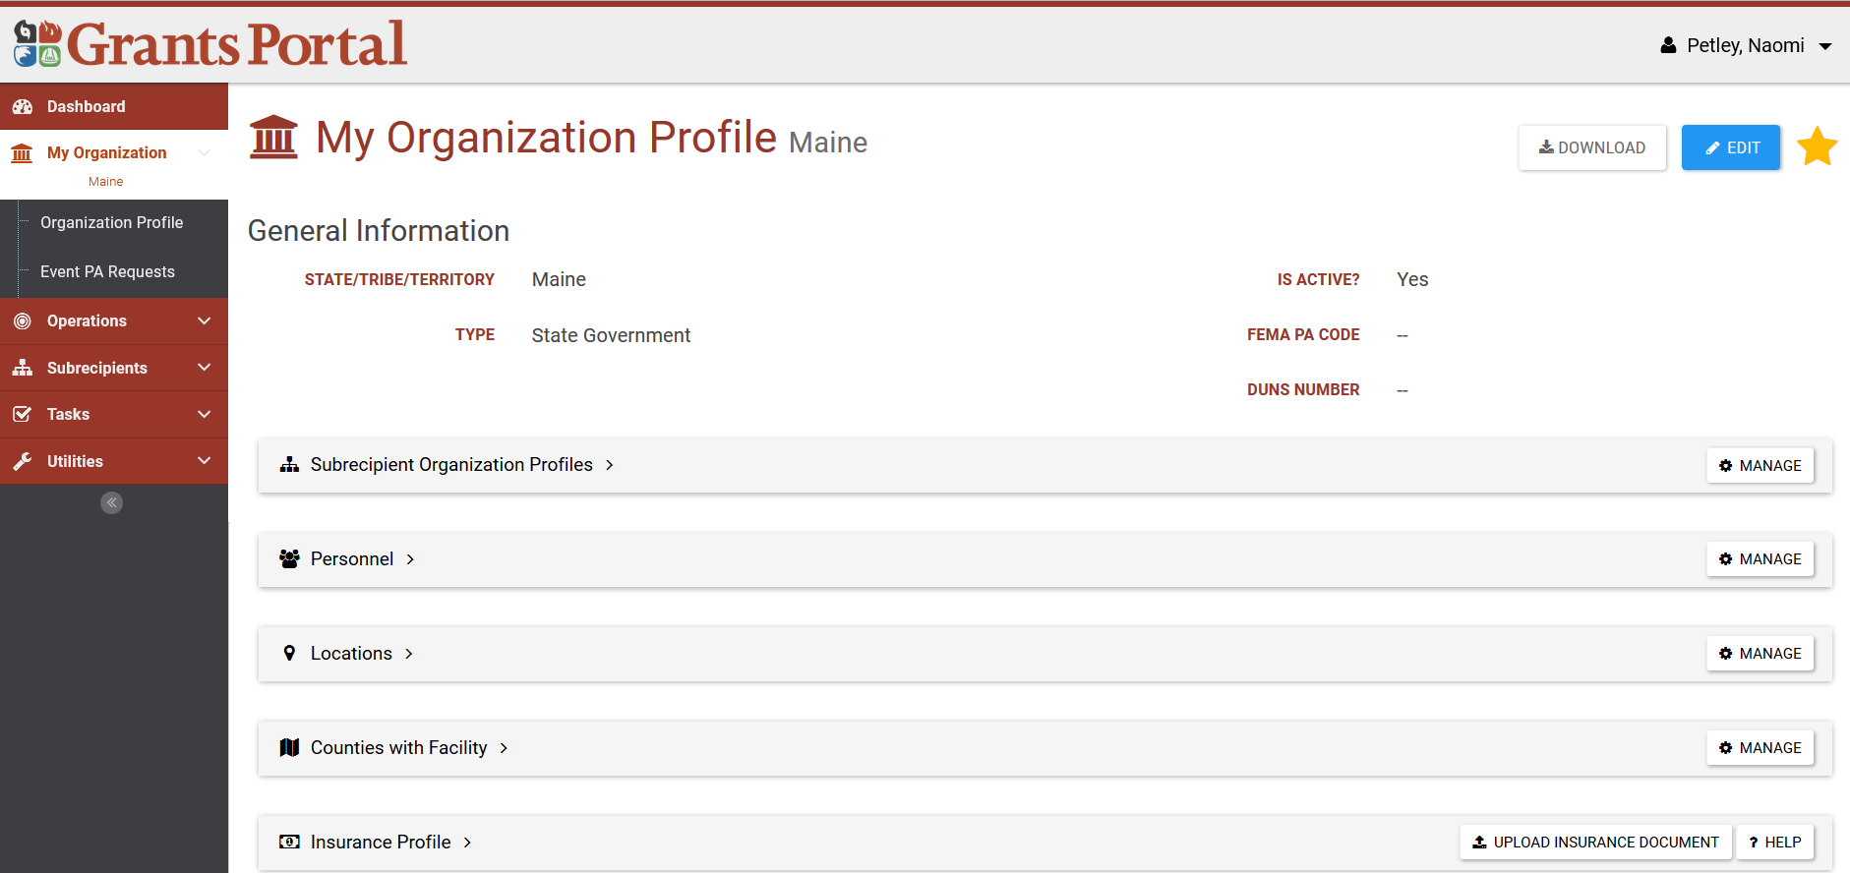
New PA Delivery Model

Slide 47
Important Web Links
FEMA Website:
https://www.fema.gov/public-assistance-local-state-tribal-and-non-profit
Schedule of Equipment Rates:
https://www.fema.gov/schedule-equipment-rates
FEMA Public Assistance Program and Policy Guide (PAPPG)
https://www.fema.gov/media-library/assets/documents/111781

